Slide 1
Learning as Abduction
Lasha Abzianidze
33rd ESSLLI in Gaillimh, Éire 8-12 August 2022

Slide 2
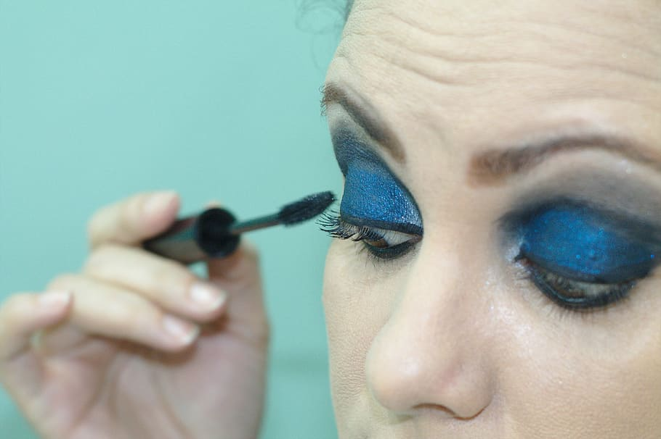
Many failed proofs (low recall)
Parser error
A small boy in a yellow shirt is laughing on the beach
C/N There is no small boy [in a yellow shirt [laughing on the beach]]
A man and a woman are shaking hands
E/N Two persons are shaking hands
Missing inference
rule
It is raining on a walking man
E/N A man is walking in the rain
https://www.pxfuel.com/en/free-photo-jvuvg
25% of errors
A man and woman are talking
C/N A man and a woman are silent
Missing lexical knowledge
Someone is holding a hedgehog
E/N Someone is holding a small animal
50% of errors
L. Abzianidze (2015): A tableau prover for natural logic and language
Notes:
llinois-LH 84.6
C%C 79.93; EasyCCG 79.05
prawn#1, shrimp#2

Slide 3
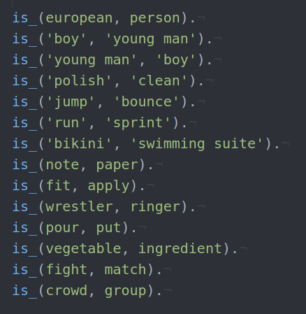
Hand crafted rules
During the adaptation to the SICK-trial, missing lexical knowledge was added by hand:

Slide 4
Approaches to NLI
Reasoning with Logic
Deep Learning
Learn from Data
robust
scalable
easy to deploy
no semanticists
Learn Lexical
Knowledge
Complex
reasoning
puppy $⊑$ young dog
slice $⊑$ cut
guitar $|$person
put on $|$ take off
Interpretability
NLI
Notes:
complex reasoning including
correctly modeling semantically challenging sentences (covering negation, correct scope, disjunction, quantifiers)
or chaining meaning of several premises
Common to all knowledge-based systems is the difficulty of acquiring the background knowledge required to determine entailment (Dagan et al., 2013)

Slide 5
Learning as abduction
A clown is putting eyeshadow on
put on$|$remove
The person is quickly removing make-up
KB
WordNet
Proving
Abduction
eyeshadow $⊑$ make-up
clown $⊑$ person
Neutral
$≠$
Contradiction
Contradiction
put on $|$ remove
A clown is putting eyeshadow on
The person is quickly removing make-up
Notes:
WordNet: 155,327 words organized in 175,979 synsets for a total of 207,016 word-sense pairs

Slide 6
Abductive reasoning in logic
Inference to the best explanation
$$E$$
$$∧$$
$$⊨$$
Premise
Conclusion
No sprinklers
The lawn is wet
Lovely little puppy is sleeping
lovely $|$ little
lovely $⊑$ little
$E$ is consistent with Premise
In the NLI context
$$≤$$
puppy $⊑$ dog; lovely $⊑$ little
puppy $⊑$ dog
$E$ is minimal
lovely little black puppy $⊑$ dog
puppy $⊑$ dog
$E$ has a pre-defined forms
Mayer & Pirri (1993)
Notes:
Reasoning to the best explanation

Slide 7
Learning as abduction
For verifying E
A lark is not moving
C Every bird is flying
$$a nestling (not \left(be move\right))$$
A nestling is not moving
C Every bird is flying
$$every bird \left(be fly\right)$$
$$nestling$$
$$c$$
$$not (be move)$$
$$c$$
KB
lark $⊑$ bird
fly $⊑$ move
$$be move$$
$$c$$
WordNet
$$nestling⊑bird$$
$$move$$
$$c$$
nestling $⊑$ bird
OR
$X$
$$\overline{a}$$
$$bird$$
$$c$$
$$be fly$$
$$c$$
Reverse app
$$nestling⊑move$$
$Y$
$$\overline{a}$$
$$fly$$
$$c$$
If $X⊑Y$

Slide 8
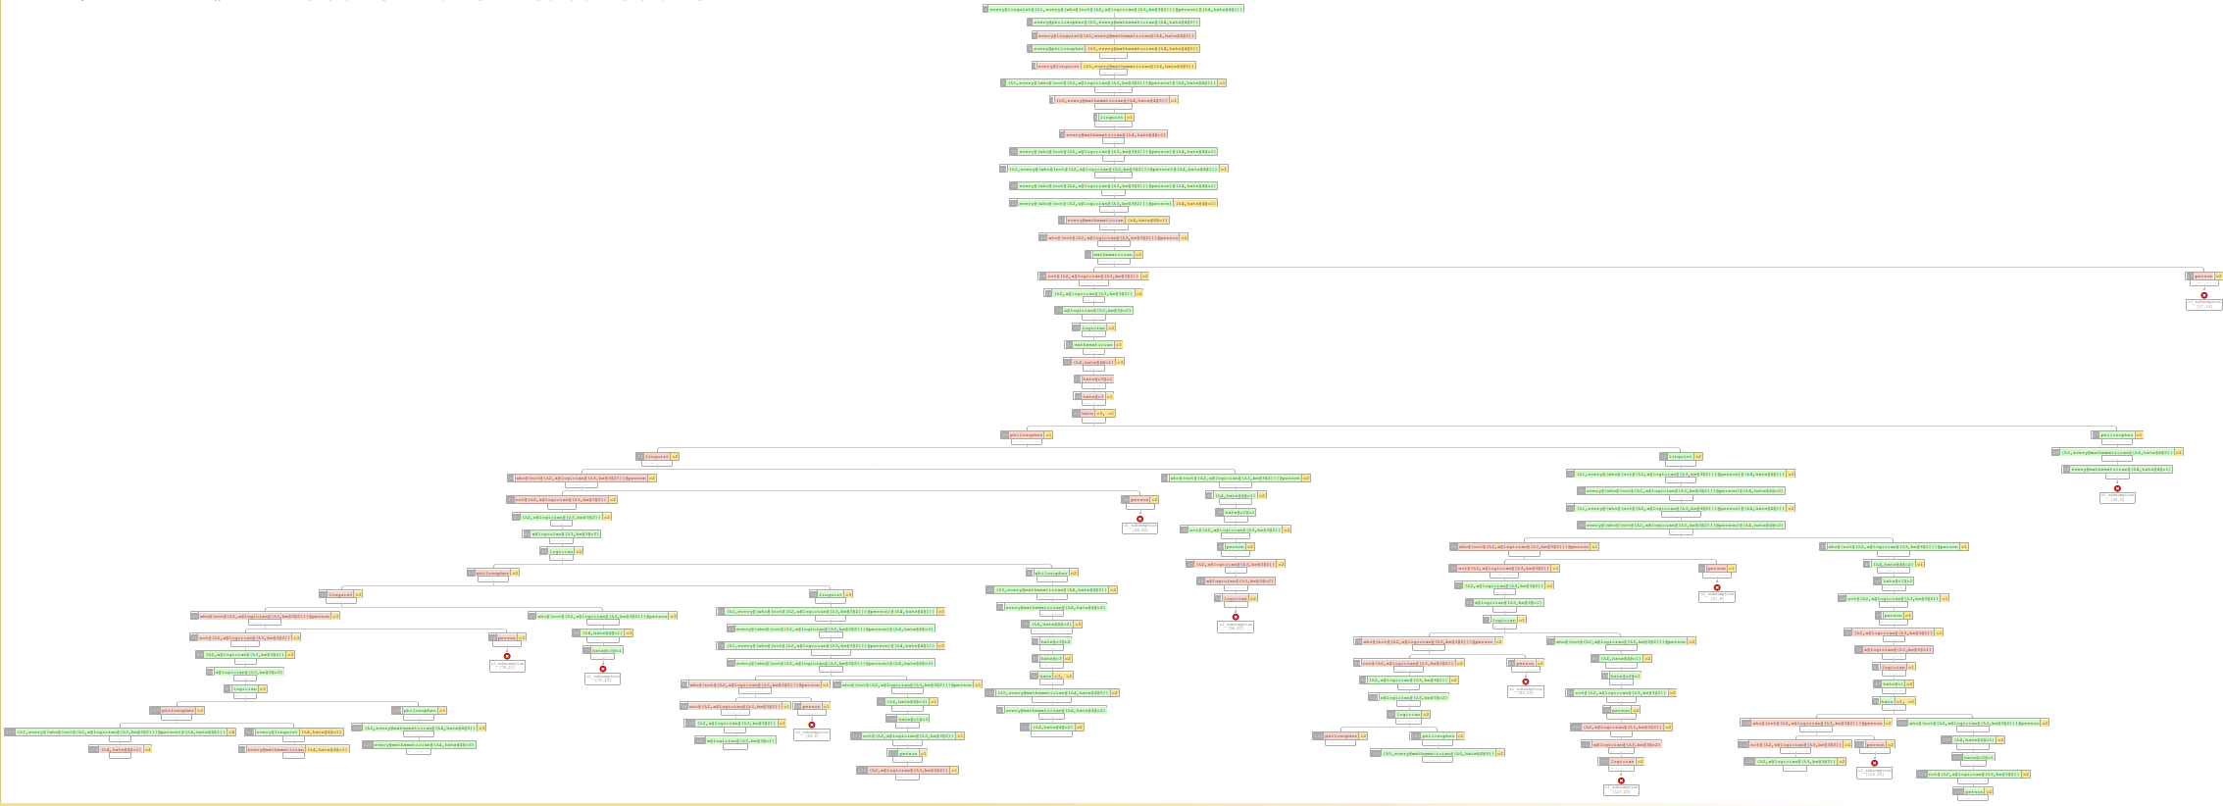
Abduction in Natural Tableau
General picture
Shrink
Explanation
Space
$$∩$$
B-set, explanation for an open branch
$X$
$$\overline{a}$$
…
T-set, explanation for an entire tableau
$Y$
$$\overline{a}$$
and other 16
closure rules
If $X⊑Y$
5,184
Possible $E$

Slide 9
Abductive learning workflow
Calculate impact based on relevant problems
Unsolved
problems
All problems
Learned
relations
2
2
3
2
LangPro
Comparable terms
Learned
KB consistent
Information amount
Impact on accuracy
Shape of terms
Reverse proving
Sentence consistent
Number of terms
Initial
3
-1
KB
Learned
$$≤$$
$$≤$$
𝐴 𝐴𝐵 (𝐴𝐵)𝐶 𝐴(𝐵𝐶)
puppy $⊑$ dog
puppy $|$ little
Abductive inference
note $⊑$ paper
toy $⊑$ car
puppy $⊑$ young dog len 3
puppy $⊑$ dog len 2
lark $|$ bird
nestling $⊑$ lark
+3 vs -0
+1 vs -2
OR
The toy car is rolling down a hill
toy $|$ car
car $⊑$ plastic vehicle
$$\text{nestling} ⊑ \text{bird}\text{, }\text{sleep} ⊑ \text{fly}$$
Incorporate learned relations and restart the learning phase if new relations were learned
$$\text{nestling} ⊑ \text{bird}$$

Slide 10
& esults
Expe iments
https://giphy.com/gifs/research-madebydot-gifathon-26FPC5oAdfeFPkQQE
https://giphy.com/gifs/research-madebydot-gifathon-26FPC5oAdfeFPkQQE

Slide 11
Experiment Setup
Sentences Involving Compositional Knowledge (SICK, Marelli et al., 2014)
Train 5,000 3-fold cross validation
Test 4,927 unseen data
CCG parsers:
(Clark and Curran, 2007)
(Lewis and Steedman, 2014)
(Yoshikawa et al., 2017)
LangPro:
Rule application limit: 50 & 800
C&C
EasyCCG
DepCCG

Slide 12
Ablation & Efficiency
3-fold CV on the training data, using only C&C parser
LangPro + Abduction All filters + WordNet | Av. accuracy on test fold % | CPU time (2.5GHz)
$≤$ 800 rule app. | 82.90 | 2041 min
$≤$ 50 rule app. | 82.64 | 220 min
$−$WordNet | $−$2.44 | -
Notes:
Using aligner
~30 hand crafted rules based on the training data
Add rec rectangles, add that one loop is enough

Slide 13
Results & comparison
LangPro + WN (accuracy % on test)
C&C
82.7
82.5
83.0
-1.4
-1.4
-1.2
EasyCCG
True Positives
(Entailment & Contradiction proofs)
DepCCG
$−$ Abduction
Prec %
94.3
DepCCG
84.4
-1.4
EasyC
C&C
84.3
84.2
CCG2Lambda
+P2P
EasyC
C&C
DepCCG
Yanaka et al. (2018)
Interpretation as abduction (Hobbs et al, 1988; Hobbs et al, 1993)
Abductive reasoning for robust RTE (Raina et al, 2005)
Logic-based SOTA
Notes:
+1.2
12.9
Abduction as subgraph matching with variable unification
Theorem prvers being precise in theor proof is important

Slide 14
Learned knowledge
Correct
Wrong
Contextual
Reversed
In total 312
star $⊑$ sky
ride $|$ get
A barefoot man in pajamas is looking toward the stars and …
E A barefoot man in pajamas is looking toward the sky and …
A small girl is riding in a toy car
C A small girl is getting out of a toy car
cap $⊑$ hat
A cyclist is biking in a snowy forest in the dark
E A cyclist is biking in a snowy forest at night
A man in a cap is playing a harp
E A man in a hat is playing a harp
in $⊑$ at
dog $⊑$ bulldog
Someone is drilling a hole in a strip of wood with a power drill
E A man is drilling a hole in a piece of wood
A monkey is brushing the dog
C The monkey is not brushing a bull dog
person $⊑$ man
acrobatics $⊑$ trick
lie down $|$ run around
... and performing acrobatics on a rail
E … and performing a trick on a rail
A squirrel is lying down
C A squirrel is running around in circles
Notes:
Easy to analyze errors: don’t forget Parser mistakes
In total 312 from training data using C7C

Slide 15
Abzianidze, L., & Kogkalidis, K. (2021). A Logic-Based Framework for Natural Language Inference in Dutch. CLIN Journal
Beyond English
Natural tableau prover
for Dutch
https://giphy.com/gifs/research-madebydot-gifathon-26FPC5oAdfeFPkQQE

Slide 16
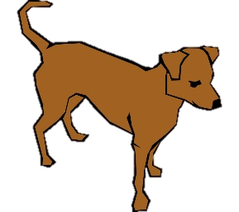
Natural tableau in
Een hond kijkt rond
Proved
$$een hond (kijken rond)$$
contradicts
$$er \left(geen\left(die rondkijken hond\right) zijn\right)$$
$$een S V$$
Er is geen hond die rondkijkt
$$geen\left(die rondkijken hond\right) zijn$$
$$S$$
$$c$$
$$V$$
$$c$$
$$geen S V$$
$$die V N$$
$$\overline{a}$$
$$hond$$
$$h$$
$$kijken rond$$
$$h$$
$$er X$$
$$S$$
$$c$$
$$V$$
$$c$$
$$V$$
$$\overline{a}$$
$$N$$
$$\overline{a}$$
$$X$$
$$die rondkijken hond$$
$$h$$
$$zijn$$
$$h$$
$X$
$$\overline{a}$$
$$X P$$
$$\overline{a}$$
$$rondkijken$$
$$h$$
$$hond$$
$$h$$
$Y$
$$\overline{a}$$
$$zijn$$
$$\overline{a}$$
$PY$
$$\overline{a}$$
If $X⊑Y$
If $X⊑Y$
L. Abzianidze & K.Kogkalidis (2022): A Logic-Based Framework for Natural Language Inference in Dutch
Notes:
+1.2
12.9
Abduction as subgraph matching with variable unification
Theorem prvers being precise in theor proof is important

Slide 17
Parsing with linear λ-calculus
Parses are $λ$-terms typed with linear types:
Terms and types come with modalities that correspond to dependency relations (but we won’t use the dependency relations).
A boy plays
ÆTHEL: Automatically Extracted Typelogical Derivations for Dutch (Kogkalidis et al., LREC 2020)

Slide 18
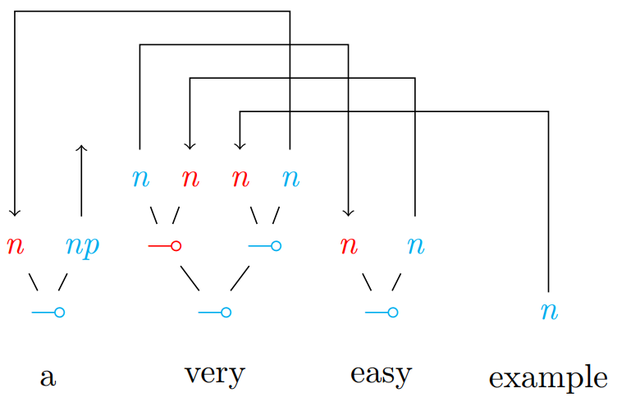
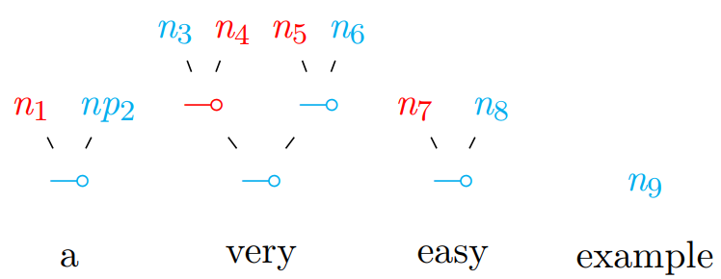
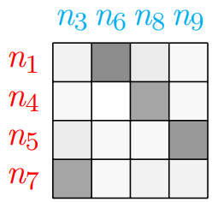
Parsing with proof nets
seq2seq for supertagging: assign types to tokens
Proving with approximating permutation matrices with the Sinkhorn operator.
a ((very easy) example)
Neural Proof Nets (Kogkalidis et al., CoNLL 2020)

Slide 19
Syntactic λ-terms to λ-logical forms
Notes:
Map POS tags and shift to slightly Generalized POS tags: UPOS & Penn I Use only these syntactic categories: n, npx, sx, pp, pr I Function words 7! canonical terms (excl. prepositions)

Slide 20
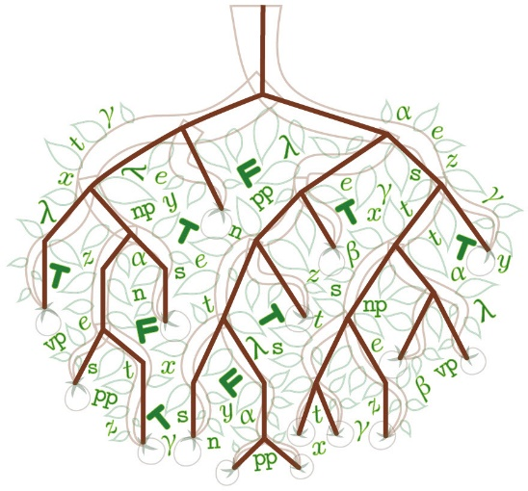
Language Theorem Prover
(Postma et al. 2016)
LangPro
Relations
Syntactic parser
Logical
Form
generator
Natural
Tableau
prover
Premises
Trees
Terms
Prediction
Hypothesis
Alpino (Bouma et al. 2001)
Neural Proof Net (Kogkalidis et al. 2020)
(Wijnholds & Moortgat, 2021)
L. Abzianidze & K.Kogkalidis (2022): A Logic-Based Framework for Natural Language Inference in Dutch
Notes:
Uses minimum resources for logic-based system

Slide 21
Results & comparison
LangPro + ODWN (accuracy % on test)
Models Accuracy(%) +LangPro $Σ$
Alpino
78.0
77.0
78.8
-1.7
-1.4
-1.6
BERTje
82.0 | (-0.2) 81.8
81.7 | (+0.9) 82.6
79.9 | (+0.7) 80.6
Neural Proof Net
$−$ Abduction
RobBERT
LangPro $Σ$
mBERT
Some bells are ringing near a cook slicing peppers
N A cook is slicing some bell peppers
Een man schopt een voetbal
E Een man schopt een bal
Er rinkelen wat belletjes bij een kok die paprika's in reepjes snijdt
N Een kok snijdt wat paprika's in reepjes
Een man draagt een boom
E Een man draagt een plant
Translation changes labels
Only LangPro𝚺
solves
A man is making a speech on a podium
N A man is speaking on a stage
Een kind slaat een honkbal
C Een kind mist een honkbal
Een man houdt een toespraak op een podium N Een man spreekt op een podium
Een familie kijkt naar een kleine jongen die een honkbal raakt
E Een jongen slaat een honkbal
Notes:
+1.2
12.9
Abduction as subgraph matching with variable unification
Theorem prvers being precise in theor proof is important

Slide 22
Learned knowledge
Correct
Wrong
Contextual
Reversed
Correct
Wrong
Contextual
Reversed
wissen $⊑$ weten
spannen $⊑$ draaien
De man is het werk van de andere man van het bord aan het wissen
E De man wist het werk van de andere man van het paneel
Een meisje in het roze spant een lint
C Er is geen meisje in het roze dat een lintje draait
op $⊑$ door
Een tijger loopt buiten een kooi
E Een tijger loopt rond een kooi
Een getrouwd stel loopt het gangpad op
E Een getrouwd stel loopt door het gangpad
buiten $⊑$ rond
persoon $⊑$ fietser
hond $⊑$ bulldog
Iemand die op fietsen rijdt, in een zwart en rood uniform, staat op een crossmotor
E Een fietser in een zwart en rood uniform staat op een crossmotor
Een aap borstelt de hond
C De aap borstelt geen bulldog
voedsel $⊑$ pizza
lopen $⊑$ rennen
Er is geen man die voedsel eet
E Een man eet een pizza
Twee witte honden lopen snel samen
E Twee witte honden rennen samen
Notes:
Easy to analyze errors: don’t forget Parser mistakes
In total 312 from training data using C&C

Slide 23
Conclusion
One of the high results for logic-based systems on SICK dataset:
Detects errors in gold labels
Abduction boost performance to the (purely logic-based) state-of-the-art
Learning as abduction:
Training with reverse theorem proving from gold labeled problems to the missing lexical knowledge
Most of the learned knowledge is ok and the wrong knowledge doesn’t hurt much
Natural tableau theorem proving beyond English:
Adapt to Dutch (using two Dutch parsers and Dutch WordNet)
Results are comparable to the results on English
Notes:
No event semantics, no degree semantics,
No verbocean, PPDB, SUMO
No machine Learning component
Fixes PP attachment
Easy to hit SOTA

Slide 24
Concluding remarks
https://giphy.com/gifs/research-madebydot-gifathon-26FPC5oAdfeFPkQQE

Slide 25
natural tableau
FOL
Syntactic parsing, ⟦ ⟧ $λ @$
$$∃x(lark\left(x\right)∧¬move(x))$$
$$∀x(bird\left(x\right)→fly(x))$$
Blackburn & Bos (2005)
Natural theorem
proving
A lark is not moving
contradicts
contradicts
Each bird is flying
Syntactic parsing,
rewriting
$$a lark (not \left(be move\right))$$
$$each bird \left(be move\right)$$

Slide 26
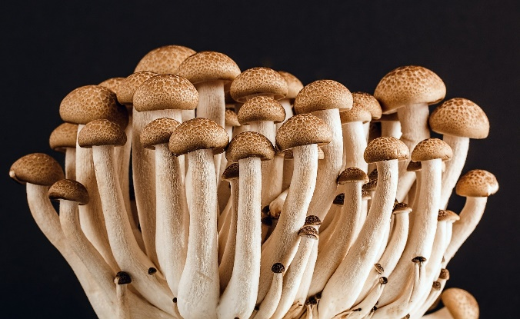
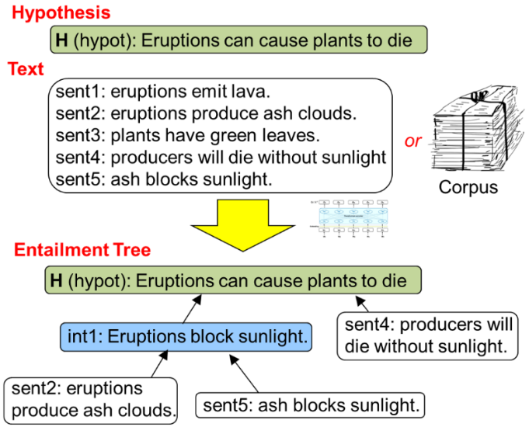
Future work
Question answering
Multi-hop reasoning
Fact verification
Adapt to new natural language understanding tasks
Model more semantic phenomena:
Combine with distributional semantics and deep learning
Go multilingual
Apply in psychology of reasoning
Presupposition & anaphora
Comparatives
Spatial expressions
Temporal expressions
Universal dependencies $→$ LLFs
Universal semantic tagging (Abzianidze & Bos, 2017)
Similarity/relatedness for KB
Learning to guide ATP
Creating a proof bank for explainable NLI
Weighted tableau rules
Admissible rules
Notes:
Mental models, cognitive psychology
Nick Chater & Mike Oaksford's probability heuristic model
Human Reasoning and Cognitive Science by Stenning & Lambalgen

Slide 27
References
Lasha Abzianidze. 2015. A tableau prover for natural logic and language. EMNLP.
Abzianidze, L. (2016). Natural solution to fracas entailment problems. *SEM 2016.
Lasha Abzianidze. 2017. A natural proof system for natural language. Ph.D. thesis, Tilburg University.
Lasha Abzianidze. 2017. LangPro: Natural language theorem prover. EMNLP.
Stephen Clark and James R. Curran. 2007. Widecoverage efficient statistical parsing with CCG and log-linear models. Computational Linguistics, 33(4):493–552.
Mike Lewis and Mark Steedman. 2014. A* CCG parsing with a supertag-factored model. EMNLP.
Lawrence S. Moss. 2010. Natural logic and semantics. In Maria Aloni, Harald Bastiaanse, Tikitu de Jager, and Katrin Schulz, editors, Logic, Language and Meaning: 17th Amsterdam Colloquium.
Reinhard Muskens. 2010. An analytic tableau system for natural logic. In Maria Aloni, Harald Bastiaanse, Tikitu de Jager, and Katrin Schulz, editors, Logic, Language and Meaning, volume 6042 of LNCS, pages 104–113.
Hitomi Yanaka, Koji Mineshima, Pascual MartınezGomez, and Daisuke Bekki. 2018. Acquisition of phrase correspondences using natural deduction proofs. NAACL.

Slide 28
References (2)
Alonzo Church. 1940. A formulation of the simple theory of types. Jurnal of Symbolic Logic, 5(2).
Richard Montague. 1970. English as a formal language. In Bruno et al. (eds.) In Visentini, editor, Linguaggi nella societa e nella tecnica. Milan: Edizioni di Co-munita.
Lawrence S. Moss. 2010. Natural logic and semantics. In Maria Aloni, Harald Bastiaanse, Tikitu de Jager, and Katrin Schulz, editors, Logic, Language and Meaning: 17th Amsterdam Colloquium.
Reinhard Muskens. 2010. An analytic tableau system for natural logic. In Maria Aloni, Harald Bastiaanse, Tikitu de Jager, and Katrin Schulz, editors, Logic, Language and Meaning, volume 6042 of LNCS, pages 104–113.
Hitomi Yanaka, Koji Mineshima, Pascual MartınezGomez, and Daisuke Bekki. 2018. Acquisition of phrase correspondences using natural deduction proofs. NAACL.
Alonzo Church. 1940. A formulation of the simple theory of types. Jurnal of Symbolic Logic, 5(2).
Richard Montague. 1970. English as a formal language. In Bruno et al. (eds.) In Visentini, editor, Linguaggi nella societa e nella tecnica. Milan: Edizioni di Co-munita.

Slide 29
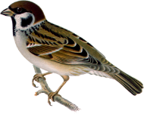
Attribution
Free Icons from the Streamline Icons Pack: ttps://streamlineicons.com
Most of the cliparts are take from: https://pixabay.com
https://giphy.com/gifs/research-madebydot-gifathon-26FPC5oAdfeFPkQQE
https://encrypted-tbn0.gstatic.com/images?q=tbn:ANd9GcT0oYysClFwZIg9E8sbT-0QoKnrO58nShr4_IMOVr24dwgsD_GN&s
https://pngimg.com/uploads/sparrow/sparrow_PNG26.png
https://freesvg.org/img/hand-pencil.png

